Slide 1
The Role of the Registrar in State Reporting

Slide 2
What is SIRS
Student Information Repository System
Provides a single source of standardized individual student records at the State level to meet State and federal reporting and accountability requirements
Data is used for:
BEDS Collection
Funding (such as Title funding)
NYS School Report Card
Accountability determinations under ESSA
USDOE collections

Slide 3
Student Information Repository System
System for collecting student and staff data through a series of databases
Level 0
Level 1
Level 2
MAARS
WNYRIC Regional Data Warehouse
L2RPT

Slide 4
What data is collected through SIRS?
Student Data
Staff Data
Demographic
Enrollment
Program Services
Assessments
Course
Grades
Attendance
Suspension
Student Digital Resources Survey
Partner Project Program
Staff Snapshot
Staff Assignment
Teacher Assignment
Teacher Attendance
Teacher and Principal Tenure
Teacher and Principal Evaluation

Slide 5
Student Data in SIRS
Student Data | Level 0 | SIRS Template | Data Source | SIRS Manual
Who am I? | Demographics | Student Lite | SMS | Chapter 2: District of Residence Codes Graduates Career Pathways Chapter 5: District of Residence Codes Career Path Codes Credential Type Codes
Where am I? | Enrollments | School Entry/Exit | SMS | Chapter 2: Table of Reporting Responsibility Walk-in Enrollments Chapter 5: Enrollment (Beginning and Ending) Codes and Descriptions
What Program Services do I participate in? | Program Fact | Programs Fact | SMS Food Service System Frontline IEP & 504 | Chapter 5: Program Service Codes and Descriptions
What assessments have I taken? | Assessment | Assessment Fact | SMS, College Board, IB (MAARS loads 3-8 ELA/Math, Gr. 4 & 8 Science, Regents) | Chapter 5: Assessment Measure Standard Codes and Descriptions
What classes have I taken? | Course Stu/Class/Entry/Exit Course/Instr/Assign Location M.P. | Course Student Class Entry/Exit Course Instructor Assignment Location Marking Period | SMS | Chapter 3: Course Instructor Assignment Student Class Entry/Exit
What grades did I earn? | Stu/Class/Gr/Detail | Student Class Grade Detail | SMS | Chapter 3: Student Class Grade Detail
What school days have I been present or absent? | Stu/Attend/Codes Stu/Daily/Attend Day Calendar | Student Daily Attendance Day Calendar | SMS | Chapter 5: Student Attendance Codes and Descriptions
What is my access to technology at home? | Student Digital Resources | Student Digital Resources | SMS | Chapter 2: Student Digital Equity (Resources)
Am I in a Partner Project Program? (P-Tech, Smart Scholars, and Smart Transfer) | Partner Project | Partner Project Template Student Credit GPA | SMS | Chapter 1: Partner Project Fact

Slide 6
District Data Sources
Student Data Sources
Staff Data Sources
SMS*
Frontline IEP
Disability Program Service
October Snapshot
EOY Snapshot
Sp. Ed. Events
NYSAA Program Service
Frontline 504
504 Program Service
Nutrikids
Free & Reduced Lunch Program Service
Poverty Program Service
WinCap*
Infinite Campus
Course Instructor Assignment
3rd party vendors (Frontline or eDoctrina)
Staff Evaluation
* Primary data sources

Slide 7
SMS
Frontline
Nutrikids
Data Dependencies Across Systems
Start and End Dates must agree
Location/Provider must agree
Free & Reduced Lunch (FRPL) and Type of Disability (TOD) program service dates and locations/providers need to be consistent with enrollment dates and locations/providers.

Slide 8
Registrars are the Student Data Gatekeepers

Slide 9
Demographic Data
Student ID
Student Name
Birth Date
Gender
Location
Grade Level
Race/Ethnicity
Hispanic Indicator
Home Language (should not be English if an ELL)
Grade 9 Entry Date (defines graduation Cohort for Accountability)
Address and Phone Number
Guardian Name
Home phone
District of Residence (on BEDS Day)
Migrant Status
Crisis Impact
For Partner Project Fact
Education Level of Parent
Post Graduate Activity
County of Residence
For Graduates
Credential Type
Career Path
Optional
Counselor Name

Slide 10
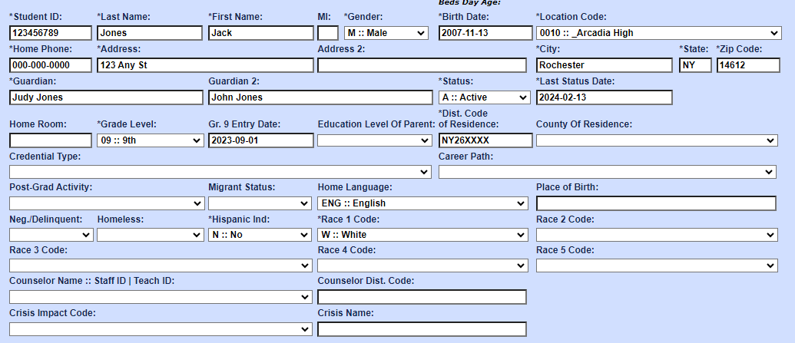

Slide 11
Demographic Data Do’s and Don’ts
Never change a student ID in the middle of a school year
For ELLs, the home language should NOT be English
Grade 9 Entry date should be the FIRST time a student was in grade 9
Use 000-000-0000 for home phone number if a phone number cannot be reported due to a confidentiality reason
Use “UNKNOWN” if an address cannot be reported due to a confidentiality reason

Slide 12
Crisis Impact (demographic)
A youth of compulsory school age presented at the school for registration that may or may not have all required documentation due to a disaster must be reported with the appropriate crisis/disaster code (category) and when known, the name of the crisis or disaster that led to the student being displaced.
The conflict in Ukraine
Hurricanes Maria, Ian, Fiona
For new registrants only – code should be removed after the first year
Code | Description | Definition
Natural | Natural disaster-induced | A natural disaster includes but is not limited to hurricanes, tropical storms, landslides, tornadoes, tsunamis, wildfire, sinkholes.
Civil | Civil conflict-induced | A civil disaster includes but is not limited to manmade intentional, accidental disasters such as war, fire accidents, and industrial accidents.
Health | Health crisis-induced | A health disaster includes but is not limited to pandemics and epidemics.
Other | Other crisis-induced | The crisis or disaster leading to the student being displaced is unclear.

Slide 13
Enrollment Data
Start Date
Entry Code
End Date
Exit Code
Location or Provider of Service
Grade Level

Slide 14
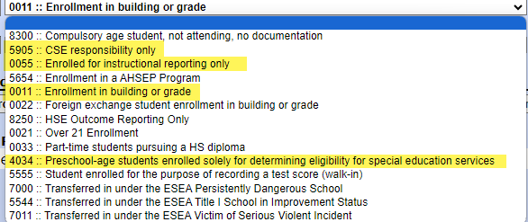
Enrollment Codes
Note: Charter Schools and Non-Public Schools only use 0011 enrollment code

Slide 15
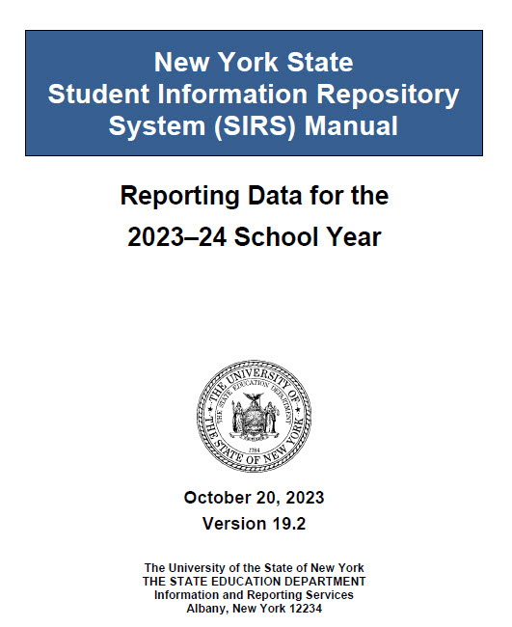
SIRS Manual & Timeline
SIRS Manual: defines data elements and provides instruction on how data elements are reported https://www.p12.nysed.gov/irs/sirs/
SIRS Reporting Timeline: includes the deadlines for data verification and certification. https://www.nysed.gov/information-reporting-services

Slide 16
Table of Reporting Responsibility
The guide for student enrollments
Provides enrollment scenarios for both school age and pre-school/PK age students

Slide 17
Description of Students | Accountability or Instructional Responsibility | CSE/CPSE Responsibility | Who Will Report Data to SIRS and Using What Code (i.e., District of Responsibility) * | Location/BEDS Code (i.e., Building of Enrollment)
1) A student who attends a school within the school district of residence | District of residence | District of residence | District of residence (Reason for Beginning Enrollment Code 0011) | Use the 12 digits of the BEDS code of the school the student attends
2) A school-age student who resides in the district and is placed by a district administrator or the CSE of the school district in educational programs outside the district (such as another school district, BOCES, approved private in-State or out-of-State school, 4201 State-supported school, or Special Act school) | District of residence | District of residence | District of residence (Reason for Beginning Enrollment Code 0011) District of attendance (Reason for Beginning Enrollment Code 0055) | School building BEDS code, BOCES code (see BOCES Codes in Chapter 5: Codes and Descriptions), code of the approved private school for students with disabilities, or the code of a 4201 State-supported school. See Location Codes for Approved Special Education Services.
3) A general-education student who resides in the district and attends a charter school | Charter school | Not applicable | Charter school (Reason for Beginning Enrollment Code 0011) | Charter school BEDS code
Most common scenarios

Slide 18
Description of Students | Accountability or Instructional Responsibility | CSE/CPSE Responsibility | Who Will Report Data to SIRS and Using What Code (i.e., District of Responsibility) * | Location/BEDS Code (i.e., Building of Enrollment)
4) A student with a disability or a student who is referred to the CSE for determination of eligibility for special education services who resides in the district and attends a charter School | Charter school | District of residence | Charter school (Reason for Beginning Enrollment Code 0011) District of residence (Reason for Beginning Enrollment Code 5905) | Charter school BEDS code
11) A student with a disability or a student who is referred to the CSE for determination of eligibility for special education services who is placed in a religious or independent (nonpublic) school by a parent/guardian | Religious or Independent (nonpublic) school (Instructional if in-state; no NYS reporting if out-of-state) Not applicable (Accountability) | District in which the Religious or independent (nonpublic) school is located (if in-state; no NYS reporting if out-of-state – any reporting would be by the out of state district of location to the state of location) | Religious or Independent (nonpublic) school participating in SIRS (Reason for Beginning Enrollment Code 0011) District in which the religious or independent (nonpublic) school is located (Reason for Beginning Enrollment Code 5905) No NYS reporting if out-of-state | Religious or independent (nonpublic) school building BEDS code for schools that are registered. School district may apply for an institution code for a “noncompliant Religious or independent (nonpublic) school” by contacting Datasupport. No NYS reporting if out-of- state
10) A student with a disability or a student who is referred to the CSE for determination of eligibility for special education services who resides in the district and is placed by a parent/guardian in another public school district | District of attendance | District of residence | District of attendance (Reason for Beginning Enrollment Code 0011) District of residence (Reason for Beginning Enrollment Code 5905 | Building of attendance BEDS code
Parentally Placed Students with Disabilities

Slide 19
Description of Students | Accountability or Instructional Responsibility | CSE/CPSE Responsibility | Who Will Report Data to SIRS and Using What Code (i.e., District of Responsibility) * | Location/BEDS Code (i.e., Building of Enrollment)
5) A general-education student who resides in the district, is in approved home schooling program | Not applicable (but district of residence must report State assessment results) | Not applicable | District of residence (Reason for Beginning Enrollment Code 0011) | First 8 digits of the district of residence BEDS code and “0888” as the last 4 digits
6) A student with a disability or a student who is referred to the CSE for determination of eligibility for special education services who resides in the district and is home schooled by parent/guardian choice | Not applicable | District of residence | District of residence (Reason for Beginning Enrollment Code 5905) | First 8 digits of the district of residence BEDS code and “0888” as the last 4 digits
37) A student with a disability who resides in the district, is home schooled by parent/guardian choice, and participates in State assessment(s). | Not applicable except that district of residence must report State assessment results | District of residence | District of residence (Reason for Beginning Enrollment Code 0011) for the day(s) of the State assessment(s) only. Reason for Beginning Enrollment Code 5905 for all other time periods. | First 8 digits of the district of residence BEDS code and “0888” as the last 4 digits
Homeschooled
Students

Slide 20
Description of Students | Accountability or Instructional Responsibility | CSE/CPSE Responsibility | Who Will Report Data to SIRS and Using What Code (i.e., District of Responsibility) * | Location/BEDS Code (i.e., Building of Enrollment)
7) A student who resides in the district, is “homebound” (temporary, long-term absence), and is associated with a school in the district | District of residence | District of residence | District of residence (Reason for Beginning Enrollment Code 0011) | Use the 12 digits of the BEDS code of the school the student would attend
8) A student who resides in the district, is homebound, and is not associated with a school in the district (is not expected to attend a school in the district) | District of residence | District of residence | District of residence (Reason for Beginning Enrollment Code 0011) | First 8 digits of the district of residence BEDS code and “0777” as the last 4 digits
Homebound/ Home Instruction
Guidance: if you want to maintain a schedule and gradebook for the student in a school, then enroll them in the school.
Student Daily Attendance must be taken for any homebound student no matter how they are enrolled

Slide 21
Description of Students | Accountability or Instructional Responsibility | CSE/CPSE Responsibility | Who Will Report Data to SIRS and Using What Code (i.e., District of Responsibility) * | Location/BEDS Code (i.e., Building of Enrollment)
21) A student who resides in a State agency facility and attends an educational program operated by the State agency. State agencies include: Office of Children and Family Services (OCFS), Office of Mental Health (OMH), Office for People with Developmental Disabilities (OPWDD), and the Department of Corrections and Community Supervision (DOCCS). (Pages 2, 12, 31, and 40 of Education Responsibilities for School-Age Children in Residential Care) | State agency | State agency | State agency (Reason for Beginning Enrollment Code 0011 or AHSEP 5654) | Facility location operated by the State agency code or BEDS code of the approved AHSEP program
27) A student in residential care (not placed by a school district) in one of the following programs: Private psychiatric hospitals or private psychiatric units within general hospitals; Short term crisis residence; Residential Respite Programs; Drug Free Residential, In Patient Rehabilitation, Alcoholism Detoxification, Residential Chemical Dependency for Youth Programs, Inpatient Rehabilitation, Acute Care Programs, Primary Care Alcohol Crisis Centers, or Community Residences–Recovery Homes; and Pediatric Residential Health Care Facilities, Hospitals, Rehabilitation Centers, or Skilled Nursing Facilities (Pages 5, 10, 22, 43, and 46 of Education Responsibilities for School-Age Children in Residential Care) | District in which parents reside or, for students in department of social services care, the district in which student resided at the time the student was placed in a program | District in which parents reside or, for students in department of social services care, the district in which student resided at the time the student was placed in a program | District in which parents reside or, for students in department of social services care, the district in which student resided at the time the student was placed in a program (Reason for Beginning Enrollment Code 0011) | If the student attends a BOCES or school in a district, use the BEDS code of the BOCES or the district school building attended by the student. If not, use the first 8 digits of the BEDS code of the district in which the parent resides and then “0777” for the last four digits.
Western NY Children’s Psychiatric Center is a OMH facility
State
Vs
Private

Slide 22
Exit the student’s enrollment even if the student is placed through CSE at NYS for the Blind
Description of Students | Accountability or Instructional Responsibility | CSE/CPSE Responsibility | Who Will Report Data to SIRS and Using What Code (i.e., District of Responsibility) * | Location/BEDS Code (i.e., Building of Enrollment)
19) A student with a disability who attends the New York State School for the Blind (NYSSB) in Batavia or the New York State School for the Deaf (NYSSD) in Rome | NYSSB or NYSSD | NYSSB or NYSSD | NYSSB or NYSSD (Reason for Beginning Enrollment Code 0011) | NYSSB or NYSSD code
31) A Kindergarten-age student with a disability who is not enrolled in Kindergarten. The student may be provided with special education services at the child’s home, in an early childhood setting, in another location, or may not be receiving special education services. | Not applicable (Accountability) District of residence (Instructional) | District of residence | District of residence (Reason for Beginning Enrollment Code 5905) | First 8 digits of the district BEDS code and “0777” as the last 4 digits Grade must be reported as “PS”
32) A child in foster care. See Students in Foster Care Toolkit for additional guidance on children in foster care. | District of attendance | District of attendance | District of attendance of student (Reason for Beginning Enrollment Code 0011) | Building of attendance BEDS code
Other Scenarios

Slide 23
Description of Students | Accountability or Instructional Responsibility | CSE/CPSE Responsibility | Who Will Report Data to SIRS and Using What Code (i.e., District of Responsibility) * | Location/BEDS Code (i.e., Building of Enrollment)
1) A preschool-age student who does not participate in a Pre-K or Universal Pre-K program referred to the CPSE or CSE for an initial evaluation to determine eligibility for special education. See definition of “initial evaluation for special education” in the glossary. | Not applicable (Accountability) District of residence (Instructional) | District of residence | District of residence (Reason for Beginning Enrollment Code 4034) | District of residence BEDS code
2) A preschool-age student with a disability who resides in the district, does not participate in a Pre-K or Universal Pre-K program and who will receive or does receive special education services from: a) an employee of a school district in a district building, the student’s home, or in another location; b) An employee of a BOCES, in a BOCES building, the student’s home or in another location; c) an employee of an approved private school for students with disabilities in that school’s building, the student’s home, or another location; d) an employee of a Section 4201 State-supported school in that school’s building, the student’s home, or another location; e) an independent service provider employed by the county in the student’s home or in another location; f) an employee of New York State School for the Blind (NYSSB) or New York State School for the Deaf (NYSSD) in these schools’ building, the student’s home, or another location. | Not applicable (Accountability) District of residence (Instructional) | District of residence | District of residence (Reason for Beginning Enrollment Code 0011) The 0011 must be reported for preschool- age students the day after they are found eligible for special | a) If the student attends a school building, use the school building BEDS code; if the services are provided at home or another location or the student is not yet receiving services, use the first 8 digits of the district of residence BEDS code and “0777” as the last 4 digits; b) BOCES BEDS code; c) Approved Private School BEDS code; d) 4201 School BEDS code; e) County BEDS code; or f) NYSSB or NYSSD BEDS code For c and e, see Location Codes for Approved Special Education Services
Preschool-age students

Slide 24
Enrollment Beginning and Ending Codes
Lists all enrollment beginning and ending codes with descriptions

Slide 25
Most Common Enrollment Codes
Reason for Beginning Enrollment
Code | Reason | Description
0011 | Enrollment in building or grade | Use this code to report enrollment of any student for whom the school/district has accountability responsibility
0055 | Enrolled for instructional reporting only | This code is used when the reporting entity does not have school/district accountability or CSE responsibility for the student (used by BOCES or a by districts when a student is placed through CSE in your district by another district)
4034 | Preschool-age students enrolled solely for determining eligibility for special education services | This code is used for preschool-age students who are referred to the CPSE or CSE for an initial evaluation to determine eligibility for special education services.
5905 | CSE or CPSE responsibility only | This code is used only by school districts to report students who have been classified as students with disabilities or have been referred to the Committee on Special Education (CSE) for determination of eligibility for special education services.

Slide 26
Completers (Graduates and other completers)
Reason for Ending Enrollment
Code | Reason | Description
High School Graduates
799 | Graduated (earned a Regents or local diploma) | Earned a diploma
High School Completers
085 | Earned commencement credential | Earned a CDOS or Skills and Achievement Commencement Credential
629 | Previously earned commencement credential | This code is used for students who earned a or commencement credential in a previous school year, subsequently continued their enrollment, and then left school without earning a high school diploma.
HSE
816 | Earned a High School Equivalency (HSE) Diploma | This code is used to indicate students who have earned a high school equivalency (HSE) diploma from an approved AHSEP program (ends a 5654 record) or those students reported with an enrollment entry code 8250 – HSE Outcome Reporting Only.

Slide 27
Transfers
Reason for Ending Enrollment
Code | Reason | Description
153 | Transferred to another school in this district or to an out of district placement | This code is used when a student transfers to a school within the same school district or is placed in an out-of-district setting by the CSE or school or district administrators or agents for any reason. The out-of-district setting could be a BOCES, an approved-private placement, a State-supported school, or another public school district.
170 | Transferred to another NYS public school outside this district with documentation. Note: documentation of transfer is not required for preschool students with disabilities. | This code is used when a student, parent(s), or guardian(s) initiates a transfer to another public school outside the district or to a charter school.
204 | Transferred to a NYS religious and independent (nonpublic) school with documentation | This code is used when a student, parent(s), or guardian(s) initiates a transfer to a religious or independent (nonpublic) school.
221 | Transferred to a school outside NYS with documentation. Note: documentation of transfer is not required for preschool students with disabilities. | This code is used when a student, parent(s), or guardian(s) initiates a transfer to a school outside New York State, including to the District of Columbia or Puerto Rico.
238 | Transferred to homebound instruction provided by this district | This code is used when a district transfers a student to long-term homebound instruction (the student is unable to attend school for the remainder of the school year) and the student is no longer included on the register of a district school.
255 | Transferred to home schooling by parent or guardian | This code is used when the student is transferred to instruction being provided by parents or guardians or by instructors employed by parents or guardians. This code can also be used when a student who is being home schooled transfers to home schooling in another district or state.

Slide 28
Other Circumstances
Reason for Ending Enrollment
Code | Reason | Description
140 | Special education eligibility status determined or determination process stopped for any reason | This code is used when a preschool-age child had been referred for a CPSE or CSE for determination of eligibility for special education and a decision has been made or the determination process has ended for any reason, including if the child leaves the school district or enrolls in a PreK or UPK program before a determination is made. This code should also be used in situations when the referral or consent to evaluate the student has been withdrawn prior to final determination.
323 | Transferred outside district by court order* | This code is used when a student is placed outside the district by an authority not employed by the district and not in parental relation to the student.
400 | Compulsory age student, stopped attending | This code is used when a student of compulsory age stops attending school and there is no documentation of a new enrollment at an LEA and no documentation of transfer to home schooling. This student should subsequently be reported with a beginning enrollment code of 8300 – Compulsory age student, not attending, no documentation through the end of the school year in which the student exceeds compulsory age or until another exit code becomes applicable.
0066 | Ended enrollment for instructional purposes only | This code is used to end enrollment records for students with a Reason for Beginning Enrollment Code 0055: Enrolled for instructional reporting only.
8305 | End CSE/CPSE Responsibility Only Enrollment | This code is used to end an enrollment record opened using Reason for Beginning Enrollment Code 5905 — CSE responsibility only. Also use this code when the parent/guardian does not provide initial consent for the special education services to begin.

Slide 29
Compulsory Age Students Who Stop Attending
Age of 6 to the end of the school year in which the child turns 16, or 17 for school districts that have selected 17 as the compulsory age.
Process:
Exit current enrollment with exit reason 400 – compulsory school age student stopped attending
Enroll student with 8300 enrollment code and location of 0000 using the next school day as the start date. May keep student in current grade level or use UNK
If student does not return by end of school year, continue reporting 8300 enrollment in the next school year but grade level must now be reported as UNK
If student returns to school that year
End 8300 enrollment with an exit reason of 153 – Transferred to another school in this district or an out-of-district placement.
Enroll student with 0011 enrollment in school location.
Once a student is no longer compulsory school age
Exit student with the appropriate dropout exit reason at the end of the school year in which they turned 16 or 17 using a date of June 30

Slide 30
Compulsory Age Students Who Stop Attending
Exceptions: Schools of choice (charter schools and religious and independent schools) are not required by law to report compulsory age students who stopped attending using the 8300 enrollment code. If a compulsory age student is expelled or stops attending, the appropriate exit code should be used and the school should follow their established procedures to notify the student’s district of residence. The district of residence would then be responsible for confirming that the student is being educated or, if unable to do so, the district must maintain the student enrollment using the 8300 enrollment code.

Slide 31
Program Services
8282 – Immigrant Children & Youth Status
Are aged 3-21
Were not born in any State, and
Have not been attending school in the US for more than 3 full academic years. Months need not be consecutive
8292 – Students with a Parent on Active Duty in the Armed Forces
2618 – Urban Suburban Program
8300 – Child in Foster Care
8262 – Homeless Student Status

